Slide 1
Employee Data Analysis using Excel
STUDENT NAME: MANIMEGALAI S
REGISTER NO: asunm13332213331042038
DEPARTMENT:B.COM COMMERCE
COLLEGE:BHARATHI WOMENS COLLEGE

Slide 2
PROJECT TITLE
Employee Data Analysis

Slide 3


AGENDA
Problem Statement
Project Overview
End Users
Our Solution and Proposition
Dataset Description
Modelling Approach
Results and Discussion
Conclusion
3/21/2024 Annual Review

Slide 4

PROBLEM STATEMENT
THE PROBLEM IS TO IDENTIFY THE EMPLOYEES DATA ACCORDING THEIR 1. Employee name,
2. Employer ID,
3. Department,
4. Gender,
5. Recruitment Source,
6. Salary per month .

Slide 5

PROJECT OVERVIEW
IN THIS ANALYSIS IM GOING TO EASE THE PROCESS OF IDENTIFY THE EMPLOYEES SALARY,RECRUITMENT SOURCE,DEPARTMENT USING EXCEL, WITH THE HELP OF BELOW MENTIONED TOOLS IN EXCEL.
TABLES.
SLICERS.
PIVOT CHART(LINE CHART,PIE CHART & BAR CHART).
CONDITIONAL FORMATTING

Slide 6

WHO ARE THE END USERS?
Human Resources (HR) Department
Finance Department
Compensation and Benefits Specialists
Operational Managers
IT and Data Management Teams

Slide 7

OUR SOLUTION AND ITS VALUE PROPOSITION
User-Friendly Interface:
Accessibility
Ease of Use
Comprehensive Data Management:
Data Organization
Data Integration
Advanced Analytical Tools:
Formulas and Functions
PivotTables
Visual Representation:
Charts and Graphs
Scenario Analysis:
Used to analyse different situation

Slide 8
Dataset Description
Data Overview:
The dataset contains information about employees within an organization, This data is used to calculate and analyse the project progress metrics.
Data Fields:
Employee name
Employee ID
Department
Gender
Recruitment Source
Salary per month

Slide 9

THE "WOW" IN OUR SOLUTION
Dynamic Dashboards
Advanced Data Visualization
Segmentation Analysis
Comparative Analysis
Interactive Reports
Slicers
3/21/2024 Annual Review
9

Slide 10
MODELLING
Data cleaning.
Creating table.
Creating pivot chart.
Creating dashboard.
Inserting pivot chart in dashboard.
Creating interactive dashboard by putting all together elements.
10

Slide 11

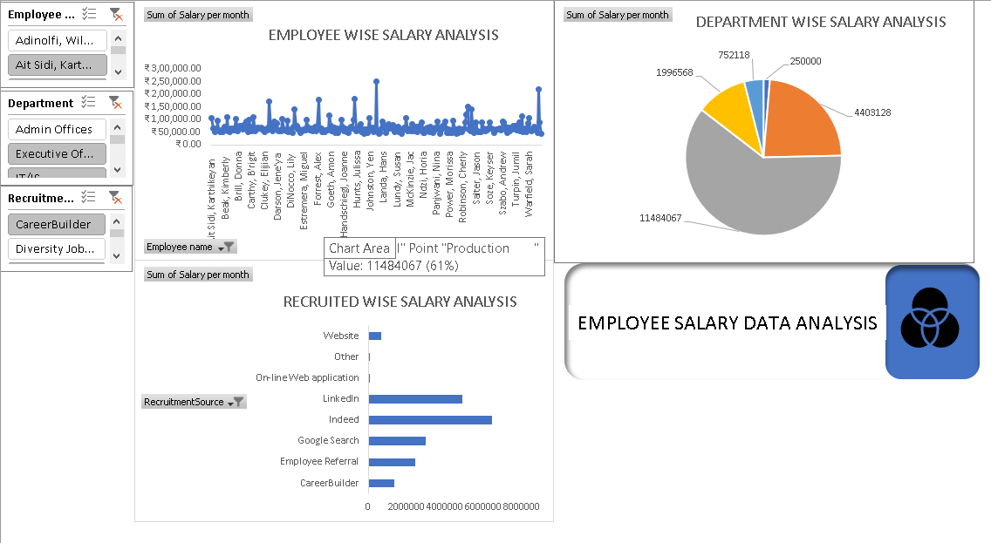
RESULTS
(click to open file)
11

Slide 12
conclusion
“the employee data analysis highlights significant disparities and provides actionable insights for refining compensation strategies, improving equity, and enhancing overall departmental performance. By addressing these findings, the organization can better align its compensation practices with its strategic objectives and improve employee satisfaction and retention”

